Slide 1
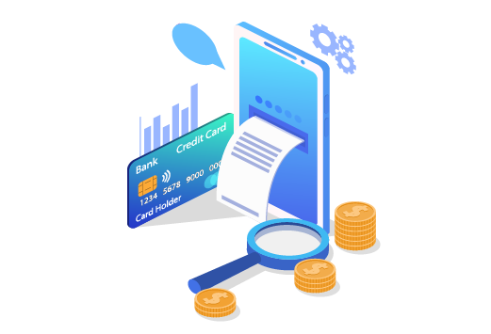
Quality Refresher

Slide 2
Billing:
Why bills increase
Billing Comparison
IDA
IBA
Billing Cycles and Prorates
TC Policies & Appointment Discipline ($80 fee for technician visit).

Slide 3
Increases
There are some reasons why a bill could increase. - Changes on Optimum standard prices. - Upgrades that customers perform in their accounts. - Promotion Expired.
One of the most common is because the customers Promotion expired.
Promotions are a way to provide customers an opportunity to enjoy what Optimum has to offer at a discounted price. They are usually good for a time period of 12 to 24 months, and they are renewed periodically until they reach the regular rate of the service.

Slide 4
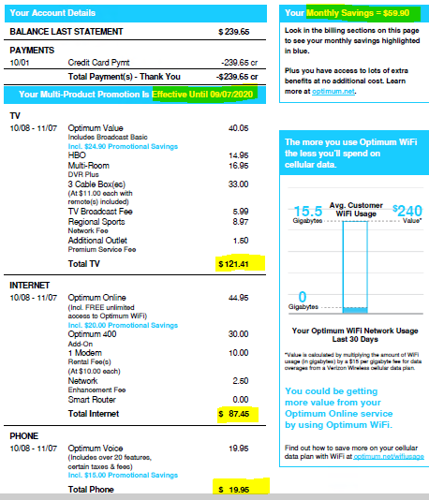
We can confirm when a promotion expired with a bill comparison.

Slide 5
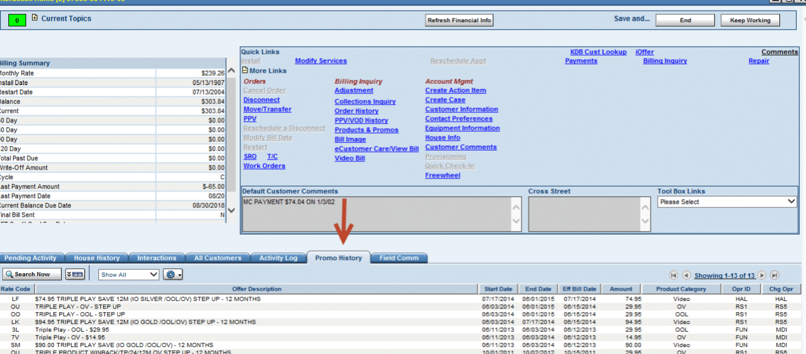
We can also view active and expired promotions in IDA on the Interactive Home Page under the Promo History Tab.

Slide 6
Balance last statement and payments
We can see here the same information. However, there are the details about the payment. For example, the payment method that the customer used in this case it was a Credit Card and the payment was for $303.56 and there was a remind balance of $121.57 because the total amount due for the previous bill was for $425.13.

Slide 7
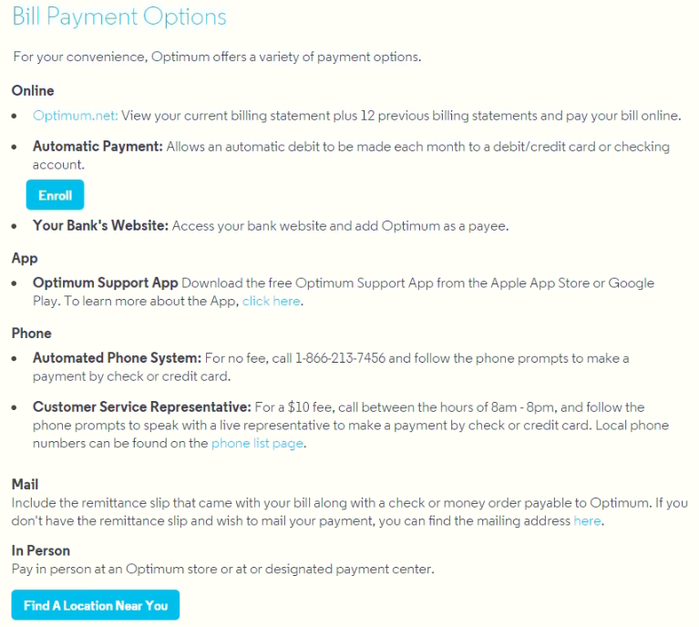
Payment Options

Slide 8
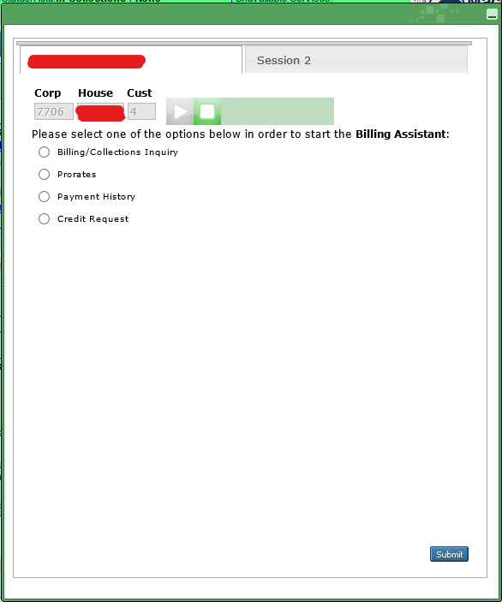
IBA: This is our intelligent Billing assistant tool. With this tool we can verify all the information related to payments, past due balance, credit request, restore services, cancel non-payment disconnect order, apply credit for services interruption and late fee.

Slide 9
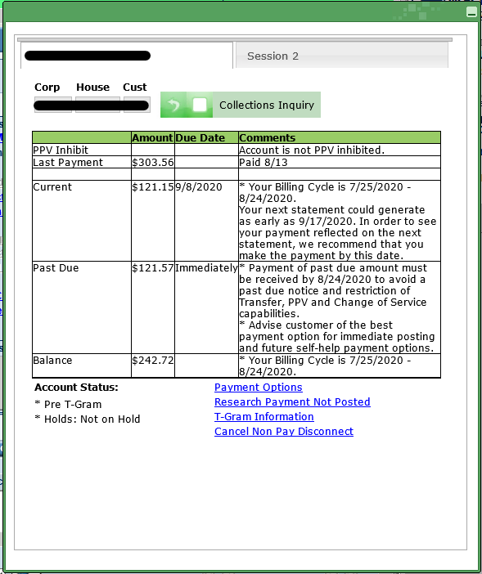
Billing/collections inquiry
We can see here the current amount.
Last payment that we received/customer did.
Past due amount.
Balance for the current month.
Billing cycle.
The cut-off day.
On account status:
We can see the payment options that the customer has. (We do not use this one)
Method for research payment that hasn’t been posted.
T-gran information/notification
Cancel Non-pay disconnect process.

Slide 10
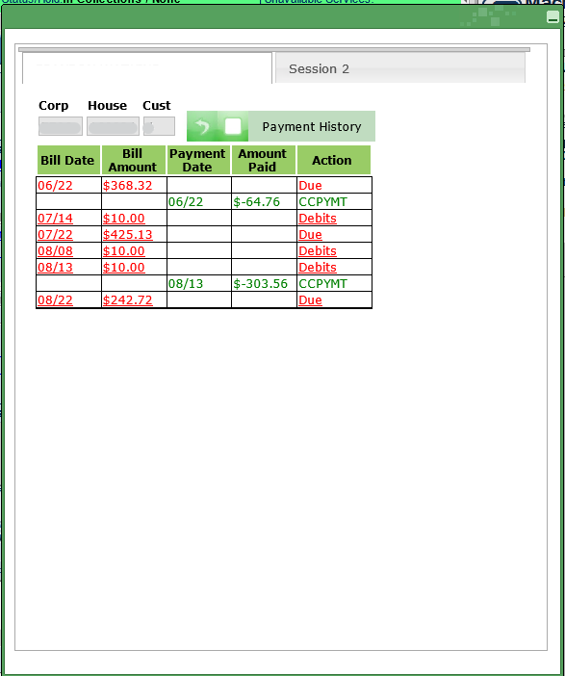
Payment History. Here we can see the last three months payments activities.

Slide 11
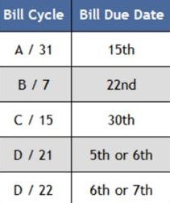
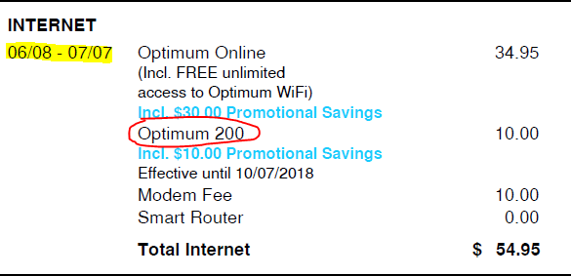
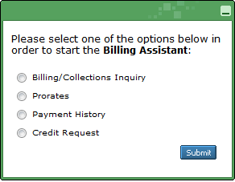
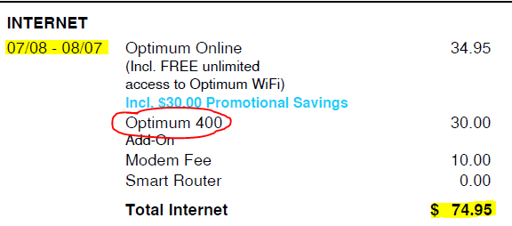
Prorated Charges & Billing Cycles.
Billing cycles are assigned depending on installations dates.

Slide 12
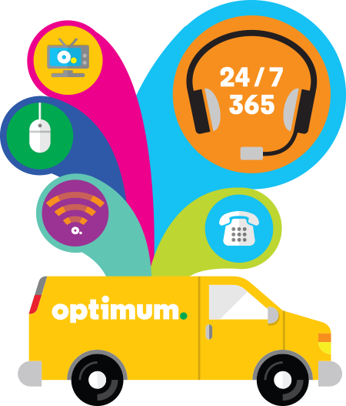
TC Policies and Appointment Discipline.
When we talk about the TC Policies, we refer to the possible $80 fee for the trouble call.
The Appointment Discipline is related to advising a customer that someone over the age of eighteen needs to be home at the day of the visit and if they cancel at the door they may be subject to the $80 charge of the trouble call.
We always need to inform the customer about the trouble call fee AND appointment discipline when scheduling an appointments.

Slide 13
Service Protection Plan.
Optimum’s Service protection plan provides customers with a worry-free experience by covering them from unexpected service visit fees.
The SP must be offered to the Account Holder and Authorized user (CPNI is not required to add it), also they can add it with the technician once he gets to their house. It’s very important to always offer the service protection plan on the interaction when scheduling an appointment as this will avoid future billing complains about the $80 fee.
If customer’s account does not have service protection added and a TC fee is being applied, please go to IDA/House History and find the Complete appointment notation the TC code to confirm if the fee is applicable, for more information about chargeable TC Codes please visit KDB article ‘’List Of Trouble Call & SRO Codes’’.

Slide 14
What are the repairs that SP does not cover?
Service Protection (SP) – Exclusions.
SP does not cover the following repairs and other services (although the cost of the service visit is covered):
Repair of wire concealed within a wall or other inaccessible structure (i.e., wire that is wall fished);
Repair of non-Optimum equipment;
Installation or configuration of non-Optimum equipment, except for a customer-owned router or modem;
Repair or replacement of Ethernet/Cat5 cable of fittings, except as required to connect the Optimum Router to the cable modem and/or Subscriber computer;
Repair of any damage or destruction caused by fire, flood, earthquake, Acts of God, vandalism, home renovation, gross negligence or willful damage.
The Plan does not cover the cost of a schedule service visit:
In the event of a missed appointment (i.e., Subscriber is not home or does not answer door at time of service visit); or
In the event the appointment is canceled at the time of the service visit (i.e., when the technician arrives at service location).

